Slide 1
Global Trends and Economic Impact on Suicide Rates
Bibhuti Timalsina
Paul Tuck
Sarah Bolton
Kekona Soon
Stephen Babcock G-1 Consulting For International Association for Suicide Prevention 24 March 2021

Slide 2

Working together to prevent suicide
Founded in 1960 as a Non-Governmental as well non- profit Organization
Currently includes professionals and volunteers from 77 countries
Mission:
The IASP is dedicated to preventing suicide and suicidal behavior, alleviating its effects, and providing a forum for academics, mental health professionals, crisis workers, volunteers and suicide survivors.
(IASP, 2021)
Notes:
Bibhuti: The IASP, The International Association for Suicide Prevention is a non- governmental organization founded in 1960 by the Late Professor Erwin Ringel and Dr. Norman Faberow whose motto is to work together to prevent suicide. This organization currently includes volunteers and professionals from 77 countries globally. The IASP is dedicated to preventing suicide and suicidal behavior who provides a platform for academics, mental health professionals, crisis workers, volunteers, and suicide survivors.

Slide 3
Country Priorities for Suicide Prevention
Data: Suicide Rates Overview 1985 to 2016
Stakeholders: The International Association for Suicide Prevention (IASP)
Purpose: to attempt to predict which countries are at risk of higher suicides.
Notes:
Paul: The data we have worked with is Suicide Rates Overview 1985-2016. This data is licensed through the World Bank Dataset but is compiled into one dataset from four other datasets which are linked by time and place. The 4 datasets compiled include the Human development index from United Nations Development Program, World development indicators from the World Bank, WHO Suicide Statistics, and Suicide prevention also from WHO. We are presenting this data to the International Association for Suicide Prevention to help determine how a country's an effect suicide rates, which we believe can assist in determining where the IASP should invest resources to effectively fight suicide.(Rusty, 2018) We were motivated to use the factors from this dataset to help guide the IASP in making budgetary decisions about where to invest in suicide prevention.

Slide 4
Research Questions
What portion of the population is attempting more suicides?
What Impact does Economics have on suicide rates and average suicides?
What is the difference between most developed countries and least developed countries suicide rates?
Do changes in economic production influence suicide rate?
Notes:
Paul: To decide where our resources would best be focused, we asked ourselves four questions: is there an age or sex group most at risk from suicides? Does the economy of a nation impact suicide rates? Are people living in developing countries more at risk of suicides, or vice versa? And do changes in economic activity impact suicide rates of a nation? Hopefully by answering these questions, we would be able to predict which countries and people would be most at risk, and focus our resources on those countries and people that need intervention the most.

Slide 5
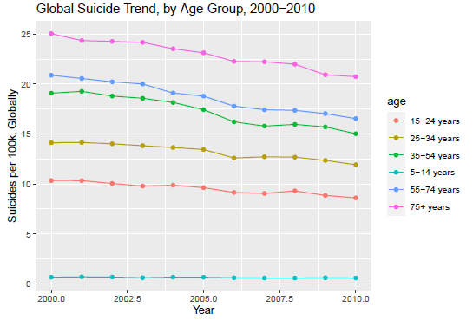
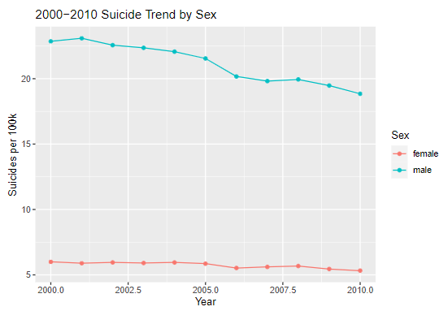
Global Trends in Suicide
Globally, Suicide is on a decline
Male are much more prone to suicide
The older you get, the more at risk you are for suicide
Notes:
Sarah: After defining our research questions, we broke down our exploratory data to the information that was most useful to our task . The visuals above show the global suicide trends by age group, and also by gender. We can see from this that Globally, suicide rates from 2000-2010 were on the decline, that the older age groups were more at risk, and that males were more likely to commit suicide than females, not by country but the average per year, globally. Our data had the Country, age, year, gender, suicide rates, suicide rates per 100 k of the population, yearly gdp, HDI and GDP per capita as well as the generations.

Slide 6
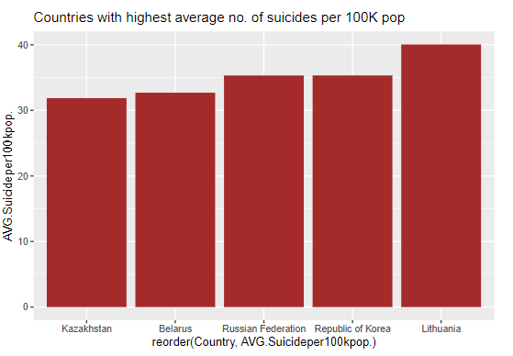
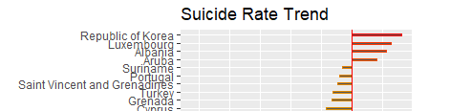
Countries of Concern
Notes:
Sarah: Another area we found from our exploratory analysis was the highest average of suicides, per 100,000 population per country. We chose to use this metric, instead of the suicide rates per country, in order to equalize our data as each country has a different population. An interesting find is that the Republic of Korea is on the list of countries with the highest average number of suicides, and also has a negative suicide rate trend , meaning their numbers continue to go up.

Slide 7
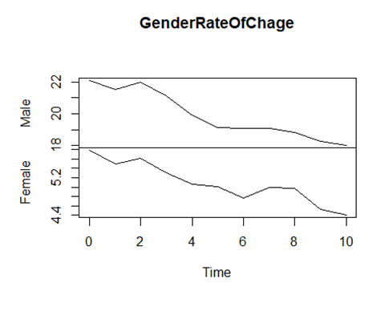
How does Gender Effect Suicide Rates?
Male Rate of Change
Sen's Slope P-value (significance) =5.161e-05
Sen's Slope= -0.4119496
Pettitt's Test for Single Point Detection P-Value= .04852
Probable Change Point=5
Female Rate of Change
Sen's Slope P-value (significance) =.0001864
Sen's Slope= -0.1221223
Pettitt's Test for Single Point Detection P-Value= .04852
Probable Change Point=5
Notes:
Sarah: Through trend analysis, we can find the rate of change as time goes on for male and female suicide rates. The slope of the lines in this image represents this change. So in our exploratory data, we saw that globally, suicide rates were going down and in this image, we see at what rate-- which is demonstrated here through the negative slope for each gender. The sen's slope for males and females are also both negative, with the males being steeper and the females being more gradual. The p-values indicate that the level for the slope to be significant. The Pettitt's Test allows us to test for when a significant change is likely to occur, and for each of these it is in the 5th year.

Slide 8
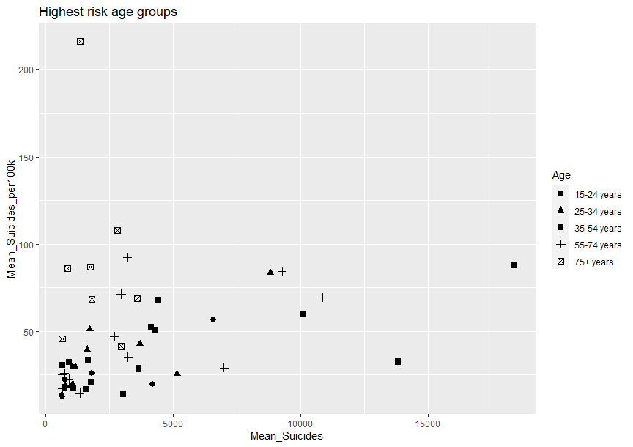
Changes By Age
High-risk for number of suicides and suicides per 100k
15-24 years 9
25-34 years 9
35-54 years 15
55-74 years 13
75+ years 8
High-risk for number of suicides per 100k
15-24 years 19
25-34 years 25
35-54 years 24
55-74 years 25
75+ years 26
Notes:
Paul: This chart shows which age groups have average yearly numbers of suicides and suicides per 100k greater than the 95 percentile of the world average, grouped by country. For all countries, those aged 35-54 years were more at risk of both suicide numbers and per_100k than any other age group. However, when only looking at suicides per 100k, those that are over 75 had the highest risk.

Slide 9
Economic Influence on Suicide Rate
Total Gross Domestic Product &
Gross Domestic Product Per Capita

Slide 10
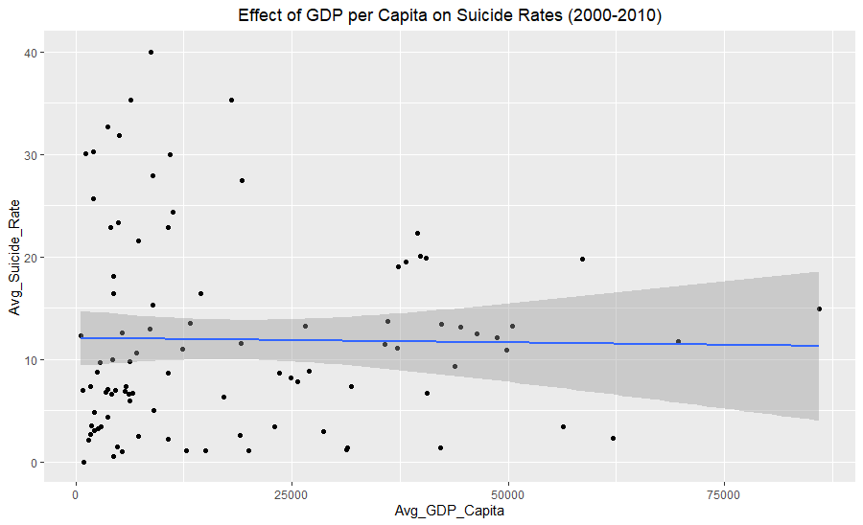
Sole effect of GDP/GDP per Capita on average suicides and suicide rates
3 Hypothesis with related regression
Correlation of Average GDP per capita on Average Suicide Rates (per 100K). Linear Regression shows minute negative effect of GDP per Capita on the Average Suicide Rate amongst countries. Correlation function in R returns: -0.01773661
Notes:
Kekona: Data is scattered in a very random way that is not well explained by GDP per Capita.

Slide 11
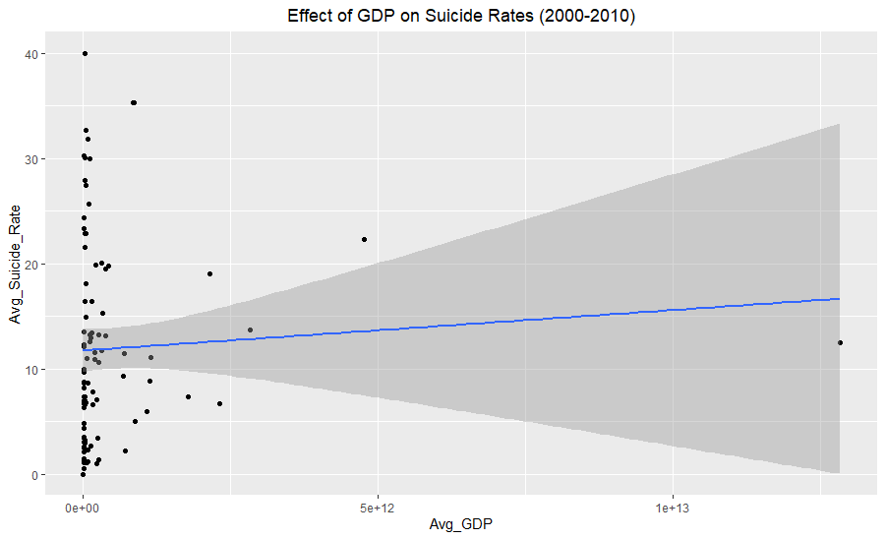
Cont.
Correlation of Average Total GDP on Average Suicide Rate. Simple Linear Regression shows slight positive effect of Average GDP on Average Suicide Rate. Correlation function in R: 0.05923996
Notes:
Kekona: A slighlty more predicitve model than the previous, but still shows a minimal effect. Positive relation does exist.

Slide 12
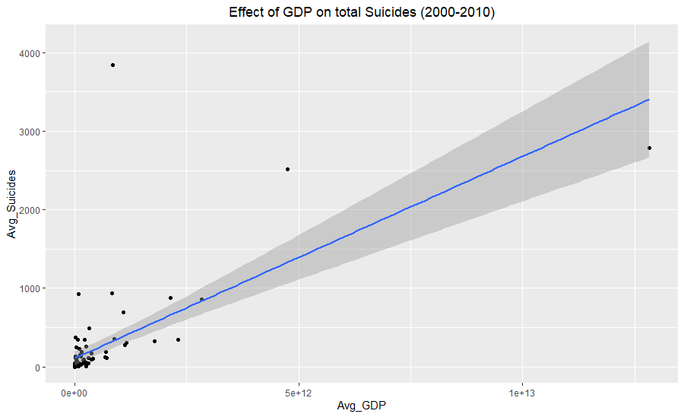
Cont.
Correlation of Average Total GDP on Avg number of Suicides. Simple Linear Regression alludes to possible connection of higher GDP countries being connected to more suicides on average. Correlation function in R: 0.6661958
Notes:
Kekona: While this model proved to show the most correlation, it can be understood that higher Total GDP countires will have higher populations and therefore higher average suicdes. Wanted to use as a point of explanation and the limitations of this model when considering other variables.

Slide 13
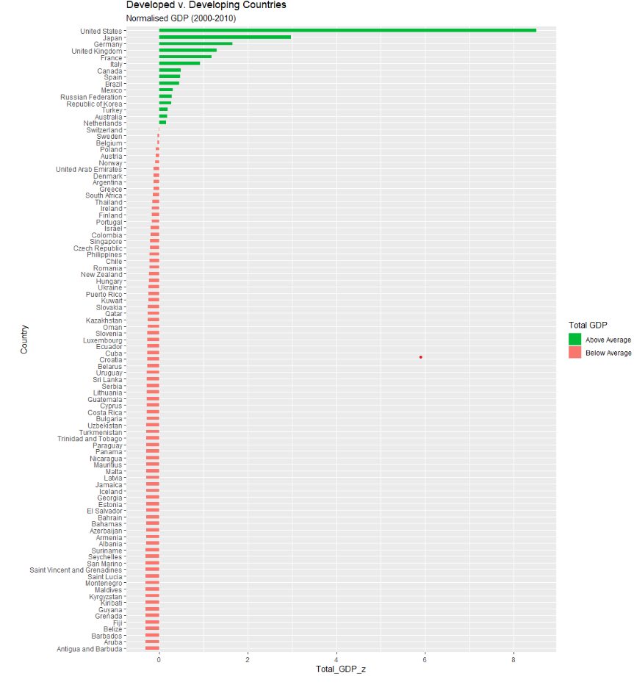
Is there a difference between developed countries and developing countries suicide rates?
Viewed Countries as Developed vs Developing by standardizing GDP average over 10 years within the dataset.
Top 10 Countries (Highest GDP 1st)
United States, 12.4591667
Japan, 22.2921212
Germany, 13.7310606
United Kingdom, 6.7153030
France, 19.0883333
Italy, 7.3181818
Canada, 11.0737879
Spain, 8.8623485
Brazil, 5.9111364
Mexico, 5.0434091
Bottom 10 Countries (Lowest GDP 1st)
Antigua and Barbuda, 1.0940000
Aruba, 8.1751515
Barbados, 1.0625758
Belize, 7.0197727
Fiji, 4.4010185
Grenada, 2.5133333
Guyana, 30.300083
Kiribati, 3.872433
Kyrgyzstan, 12.3335606
Maldives, 1.4693519
Average: 11.31
Average: 7.22
*There is most likely more similarity or even a higher average suicide rate in less developed countries due to frequency and quantity of data.*
Notes:
Kekona: Considered most developed countries to be Highest GDP countries and countries that were only –0.2 away from a zero Z-score within the data set (33 developed). Created this definition and may not actually take into account what a "developed" country actually is.
Guyana, Kyrgyzstan, have consistent data across all years unlike some of the lower end "developing" countries such as Antingua and Barbuda, Barbados, and Kiribati.

Slide 14
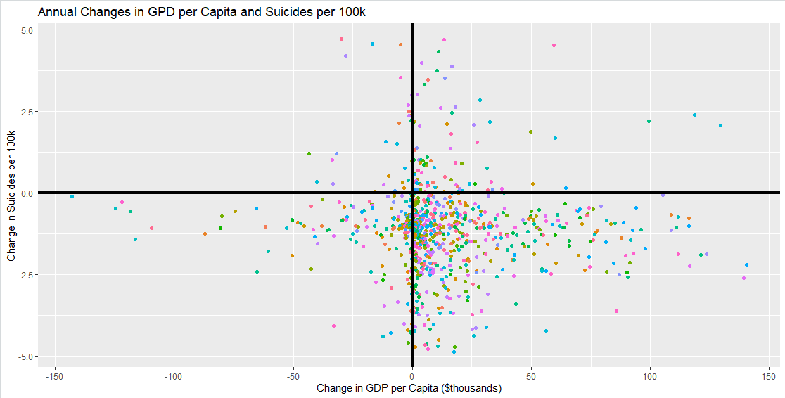
Do changes in economic production influence suicide rate?
Decrease in GDP, Increase in Suicide
Increase in GDP and Suicide
Decrease in GDP, Decrease in Suicide
Increase in GDP, Decrease in Suicide
Notes:
Steve : To study if changes in GDP have an effect on suicide rates, I looked at the annual change in GDP per capita and suicide per 100k population per country. I averaged the numbers out to identify trends per country. Few countries were trending down on GDP, and only 5 countries were trending up on suicide- these were not the same countries that were trending down on GDP. I tried a linear model against these trends, but it was near zero on the adjusted R-squared. Then I decided to look at the changes individually. The independent years are modeled above in ggplot. I did do a linear model on this as well, but it was also near zero. If there were a relation, I would expect to see a population of points in opposing corners, but instead, we see most of the points in the bottom half. All analysis I did on this data set indicates that changes in GDP is not significant enough to be used alone to predict shifts in suicide rates.

Slide 15
Take Aways
Globally, Suicides are decreasing.
The Republic of Korea is among top 5 highest suicide rate countries and is getting worse.
The highest risk group is old men.
GDP and GDP Per Capita are not effective economic indicators in predicting changes in suicide rates.
Notions that "developing" countries are worse off and therfore must be committing suicides more often is not supported.
Recommendations:
Do not solely consider changes in GDP or GDP per capita as being indicative of a countries suicide rate.
Focus efforts on Republic of Korea, Luxembourg, Albania, and Aruba as these countries have an increasing rate of suicides.
Conduct further studies that collect additional economic indicators to provide a more complete analysis on how the economy can impact suicide rates.
Notes:
Steve. Economic factors are not significant. Don't use economic data for prioritizing spending. The outlook for suicide rates globally is optimistic as it continues to decline. Continued efforts, especially focused on countries that are presenting an upward trend in suicide is recommended. We also recommend a more thorough analysis of the impact of economic factors on suicide rate, but feel more economic data is needed to provide an accurate model.

